Slide 1
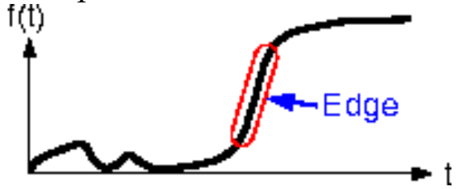
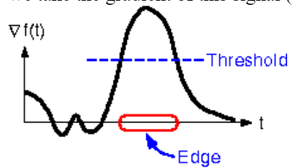
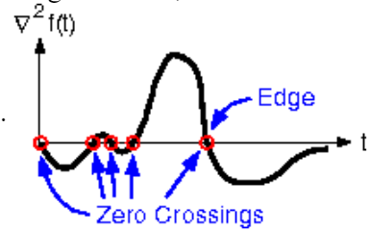
Laplacian Edge Detection (Second order derivative method)
1D image
First Derivative
Second order Derivative

Slide 2
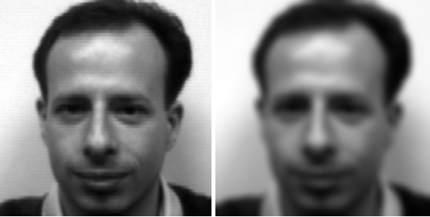


Laplacian Edge Detection (Second order derivative method)
Pros:
Easy to calculate (One pass calculation)
Cons:
Sensitive to noise
Need to apply filter before/after the edge detection
Examples:

